Slide 1

Lecture: 3
Lexical Analysis (Part 1)
CSE420 Compiler Design

Slide 2
Lexical Analysis
Basic Concepts & Regular Expressions
  What does a Lexical Analyzer do?
  How does it Work?
  Formalizing Token Definition & Recognition
Reviewing Finite Automata Concepts
  Non-Deterministic and Deterministic FA
  Conversion Process
    Regular Expressions to NFA
    Regular Expressions to DFA
Relating NFAs/DFAs /Conversion to Lexical Analysis

Slide 3
Lexical Analysis
The lexical analyzer breaks the syntaxes into a series of tokens, by removing any whitespace or comments in the source code.
Code segment:
if(x/2==0)
even=1;
else
odd=1;
The text script of this code segment:
if(x/2==0)\n\teven=1;\nelse\n\todd=1;

Slide 4
Lexical Analyzer in Perspective
token
source program
lexical analyzer
parser
get next token
symbol table
Important Issue:
What are Responsibilities of each Box ?
Focus on Lexical Analyzer and Parser.

Slide 5
Lexical Analyzer in Perspective
LEXICAL ANALYZER
  Scan Input
  Remove WS, NL, …
  Identify Tokens
  Create Symbol Table
  Insert Tokens into ST
  Generate Errors
  Send Tokens to Parser
PARSER
  Perform Syntax Analysis
  Actions Dictated by Token Order
  Update Symbol Table Entries
  Create Abstract Rep. of Source
  Generate Errors
  And More…. (We’ll see later)

Slide 6
Introducing Basic Terminology
What are Major Terms for Lexical Analysis?
  TOKEN
    A classification for a common set of strings
    Examples Include <Identifier>, <number>, etc.
  PATTERN
    The rules which characterize the set of strings for a token
    Recall File and OS Wildcards ([A-Z]*.*)
  LEXEME
    Actual sequence of characters that matches pattern and is classified by a token
    Identifiers: x, count, name, etc…

Slide 7
Introducing Basic Terminology
Token
Sample Lexemes
Informal Description of Pattern
const
if
relation
id
num
literal
const
if
<, <=, =, < >, >, >=
pi, count, D2
3.1416, 0, 6.02E23
“core dumped”
const
if
< or <= or = or < > or >= or >
letter followed by letters and digits
any numeric constant
any characters between “ and “ except “
Actual values are critical. Info is :
  1.Stored in symbol table
  2.Returned to parser
Classifies Pattern

Slide 8
Language and Regular Expressions
A Regular Expression is a Set of Rules / Techniques for Constructing Sequences of Symbols (Strings) From an Alphabet.
Let Σ Be an Alphabet, r a Regular Expression Then L(r) is the Language that is Characterized by the Rules of r.

Slide 9
Regular Expression
Alphabet { 0, 1 }
All strings that represent binary numbers divisible by 4 ((0|1)*00)
Telephone numbers of the form
  (937)-775-5134
    exchange = digit³
    phone = digit⁴
    area = digit³
    phone_number = '(' area ')-' exchange '-' phone

Slide 10
Rules for specifying Regular Expressions
Regular expressions over alphabet ∑
ε is a regular expression that denotes {ε}.
If a is a symbol (i.e., if a∈ ∑), then a is a regular expression that denotes {a}.
Suppose r and s are regular expressions denoting the languages L(r) and L(s). Then
  (r) | (s) is a regular expression denoting L(r) U L(s).
  (r)(s) is a regular expression denoting L(r)L(s).
  (r)* is a regular expression denoting (L(r))*.
  (r) is a regular expression denoting L(r).

Slide 11
Example
Let Σ = {a, b}
  The regular expression a | b denotes the set {a, b}
  The regular expression (a|b)(a|b) denotes {aa, ab, ba, bb}
  The regular expression a* denotes the set of all strings of zero or more a’s. i.e., {ε, a, aa, aaa, ….. }
  The regular expression (a|b)* denotes the set containing zero or more instances of an a or b.
  The regular expression a|a*b denotes the set containing the string a and all strings consisting of zero or more a’s followed by one b.

Slide 12
How to “Parse” Regular Expressions
Precedence:
  * has highest precedence.
  Concatenation as middle precedence.
  | has lowest precedence.
  Use parentheses to override these rules.
Examples:
  a b* = a (b*)
    If you want (a b)* you must use parentheses.
  a | b c = a | (b c)
    If you want (a | b) c you must use parentheses.
Concatenation and | are associative.
  (a b) c = a (b c) = a b c
  (a | b) | c = a | (b | c) = a | b | c
Example:
  b d | e f * | g a = (b d) | (e (f *)) | (g a)

Slide 13
Equality vs Equivalence
Are these regular expressions equal?
    R = a a* (b | c)
    S = a* a (c | b)
... No!
Yet, they describe the same language.
L(R) = L(S)
“Equivalence” of regular expressions
If L(R) = L(S) then we say R ≅ S
“R is equivalent to S”
From now on, we’ll just say R = S to mean R ≅ S

Slide 14
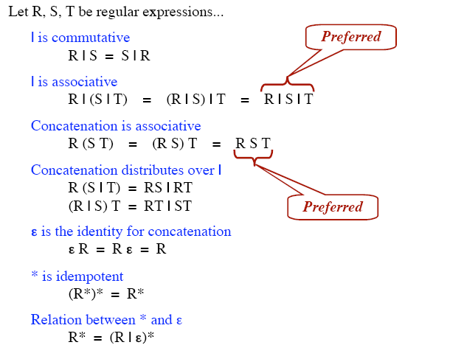
Algebraic law of regular expressions

Slide 15
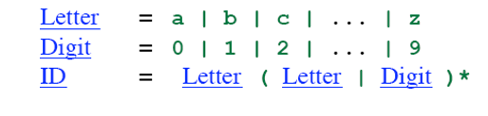
Regular Definition

Slide 16
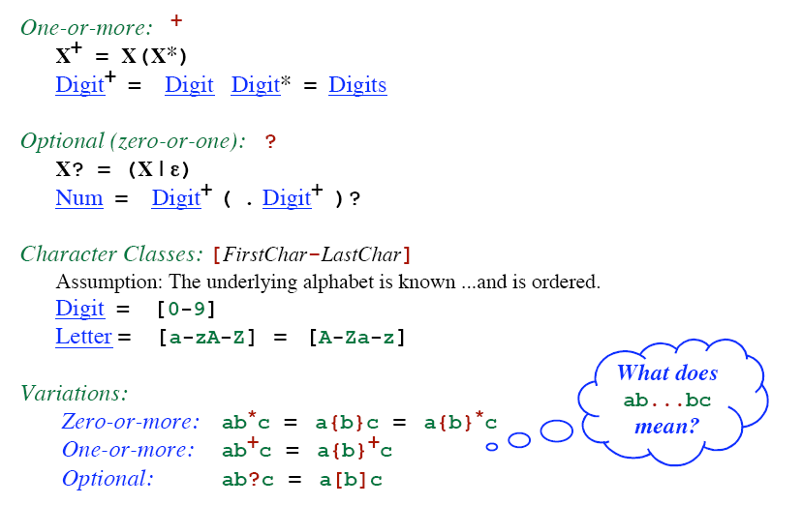
Addition Notation / Shorthand

Slide 17
Token Recognition
How can we use concepts developed so far to assist in recognizing tokens of a source language ?
Given Tokens, What are Patterns ?
digit → 0 | 1 | 2 | … | 9
id → letter ( letter | digit )*
num → digit ⁺ (. digit ⁺ ) ? ( E(+ | -) ? digit ⁺ ) ?

Slide 18
Unsigned Number
digit → 0 | 1 | 2 | … | 9
digits → digit digit*
optional_fraction → . digits | ∈
optional_exponent → ( E ( + | -| ∈) digits) | ∈
num → digits optional_fraction optional_exponent
Shorthand
digit → 0 | 1 | 2 | … | 9
digits → digit⁺
optional_fraction → (. digits ) ?
optional_exponent → ( E ( + | -) ? digits) ?
num → digits optional_fraction optional_exponent
1240, 39.45, 6.33E15, or 1.578E-41

Slide 19
What Else Does Lexical Analyzer Do?
Scan away blanks, new lines, tabs
Can we Define Tokens For These?
blank → blank
tab → tab
newline → newline
delim → blank | tab | newline
ws → delim ⁺
Ans: No token is returned to parser

Slide 20
Token Recognition
How can we use concepts developed so far to assist in recognizing tokens of a source language ?
Assume Following Tokens:
if, then, else, relop, id, num
Given Tokens, What are Patterns ?
Grammar:
stmt → |if expr then stmt
|if expr then stmt else stmt
|∈
expr → term relop term | term
term → id | num
if → if
then → then
else → else
relop → < | <= | > | >= | = | <>
id → letter ( letter | digit )*
num → digit ⁺ (. digit ⁺ ) ? ( E(+ | -) ? digit ⁺ ) ?

Slide 21
What Else Does Lexical Analyzer Do?
All Keywords / Reserved words are matched as ids
After the match, the symbol table or a special keyword table is consulted
Keyword table contains string versions of all keywords and associated token values
if
15
then
16
begin
17
...
...
When a match is found, the token is returned, along with its symbolic value, i.e., “then”, 16
If a match is not found, then it is assumed that an id has been discovered

Slide 22
End of slide

